Slide 2


Slide 3


Slide 4


X

Slide 5


Visualizing Data
Methods for Displaying Information
X

Slide 6
Visualizing Data
Visualizing data is a key aspect of data science!
It’s important to be able to convey information to others, especially people who may not have the full technical knowledge or understanding to view the raw data or statistical analysis.
X

Slide 7
Visualizing Data
As we continue learning about data visualization, you should always keep in mind:
“What is the information I want to share or story I am trying to tell? How does this visualization help in conveying that information to others?”
X

Slide 8
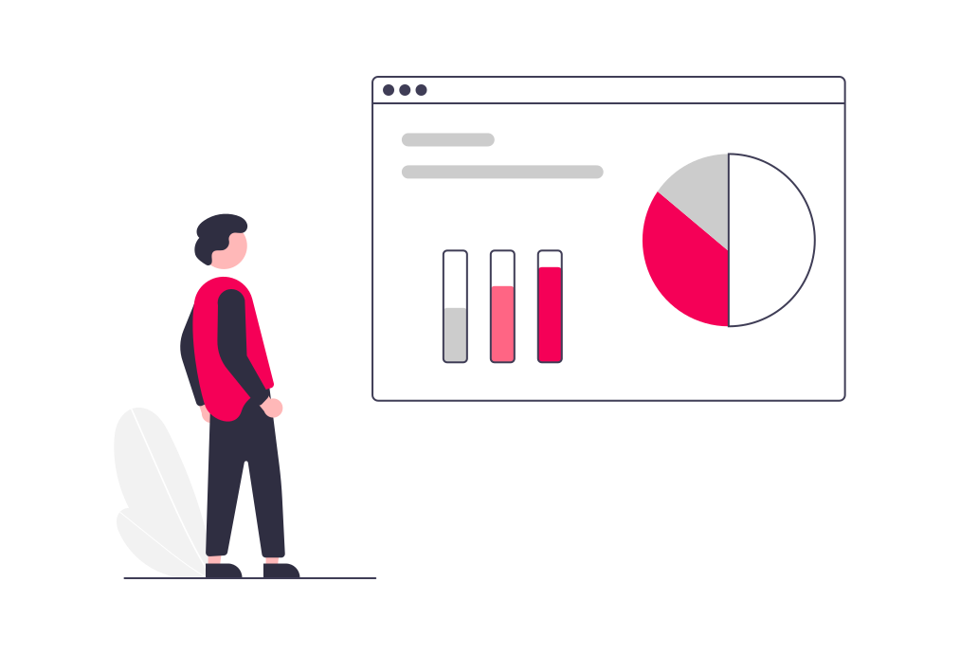
Visualizing Data
Data visualization is especially crucial in organizations because often decisions are made based on a final visualization or interpretation of the data.
X

Slide 9
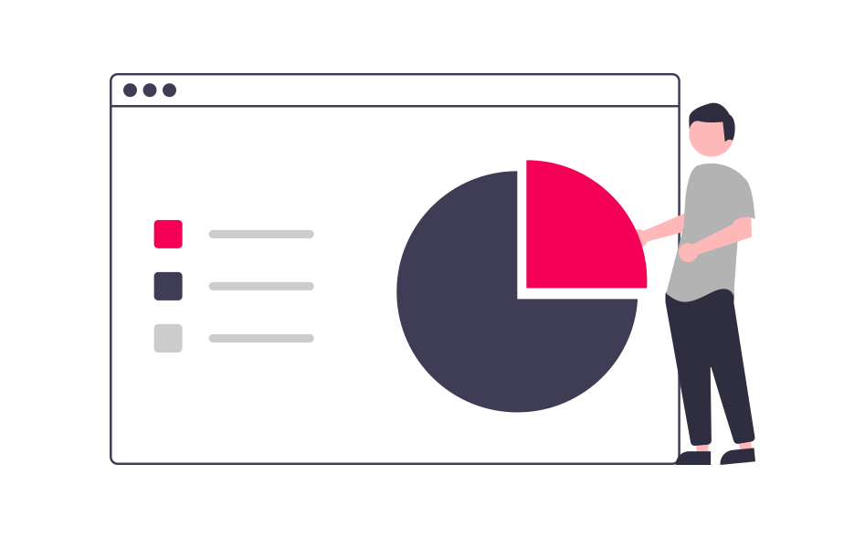
Visualizing Data
Remember that the purpose of data science at an enterprise level is to use it to make key decisions and improve products or services!
X

Slide 10

Visualizing Data
We can think of data visualization as the interface between those who work directly with data sources and those who make higher level strategic decisions in a business.
X

Slide 11

Visualizing Data
A key part of data visualization is understanding what type of plot, chart, or visualization to use.
X

Slide 12
Visualizing Data
You should also be careful with visualizations! Often information doesn’t need a pretty visual to be useful, like simple metrics (e.g. mean).
X

Slide 13
Visualizing Data
To understand which data visualization to use, let’s have a quick tour of the different data visualizations categories we’ll cover in this section:
Scatter Plots
Line Plots
Distribution Plots
Categorical Plots
X

Slide 14
Visualizing Data
For each of these plot types, we’ll slowly construct the plot step-by-step.
We’ll also briefly mention some more advanced variations for certain plot types.
X

Slide 15
Visualizing Data
Scatter Plots
X

Slide 16
Visualizing Data
Scatter Plots
A typical scatter plot will represent 2 dimensions (data features). For example, the height vs. weight of a group of people. A scatter plot can reveal relationships between two data features.
X

Slide 17
Visualizing Data
Scatter Plots
Imagine the following data set:
X

Slide 18
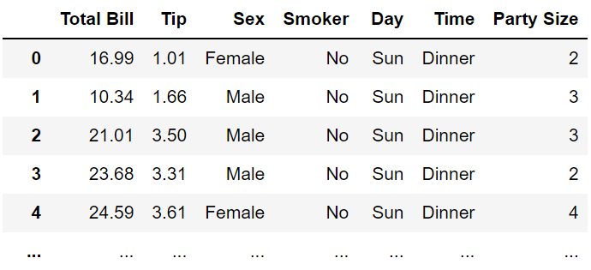
Visualizing Data
Scatter Plots
Imagine the following data set:
X

Slide 19
Visualizing Data
Scatter Plots
Is there a relationship between tip and bill?
X

Slide 20
Visualizing Data
Scatter Plots
Is there a relationship between tip and bill?
X

Slide 21
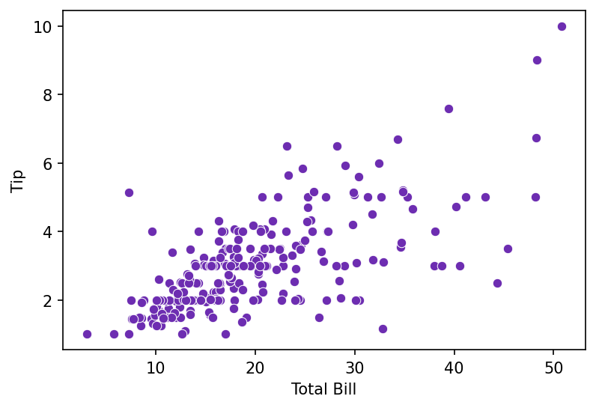
Visualizing Data
Scatter Plots
Is there a relationship between tip and bill?
X

Slide 22
Visualizing Data
Scatter Plots
Is there a relationship between tip and bill?
X

Slide 23
Visualizing Data
Scatter Plots
Is there a relationship between tip and bill?
X

Slide 24
Visualizing Data
Scatter Plots
Is there a relationship between tip and bill?
X

Slide 25
Visualizing Data
Scatter Plots
Is there a relationship between tip and bill?
X

Slide 26
Visualizing Data
Scatter Plots
Is there a relationship between tip and bill?
X

Slide 27
Visualizing Data
Scatter Plots
Tip tends to increase as Total Bill increases.
X

Slide 28
Visualizing Data
Scatter Plots - Considerations
X

Slide 29
Visualizing Data
Scatter Plots - Considerations
Adding a Trend Line
X

Slide 30
Visualizing Data
Scatter Plots - Considerations
Add transparency for stacked scatter points
X

Slide 31
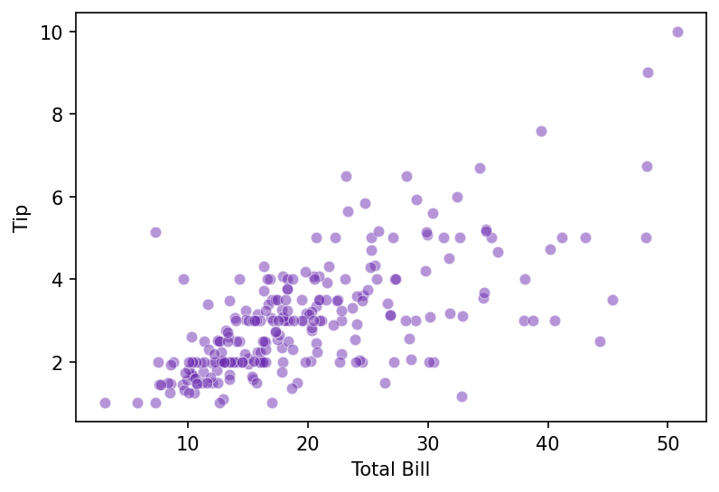
Visualizing Data
Scatter Plots - Considerations
Add transparency for stacked scatter points
X

Slide 32
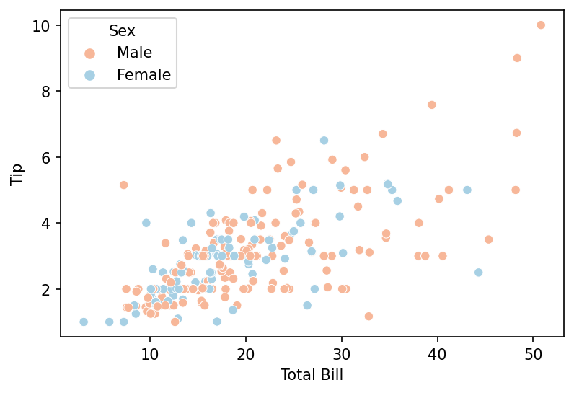
Visualizing Data
Scatter Plots - Considerations
Add more variables (data features)
X

Slide 33
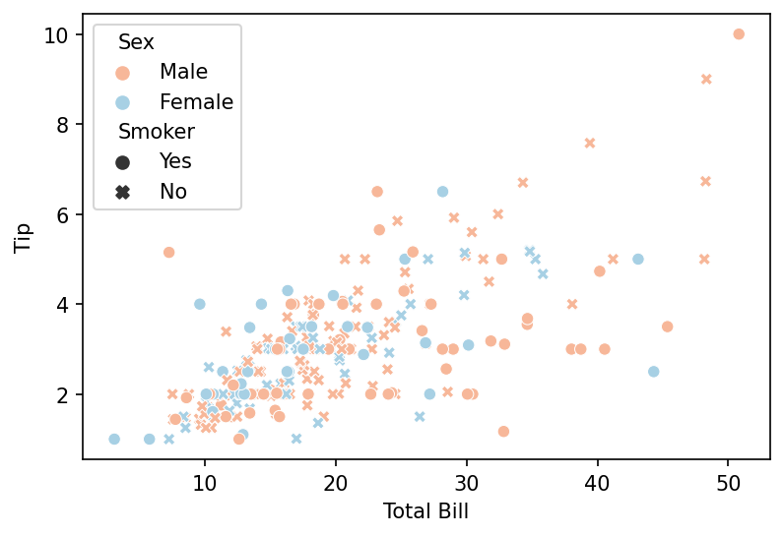
Visualizing Data
Scatter Plots - Considerations
Add more variables (data features)
X

Slide 34
Visualizing Data
Line Plots
X

Slide 35
Visualizing Data
Line Plots
Sometimes we already know there should be a continuous relationship between points along an axis. This is where we can use a simple line to indicate a known relationship between points along a data feature.
X

Slide 36
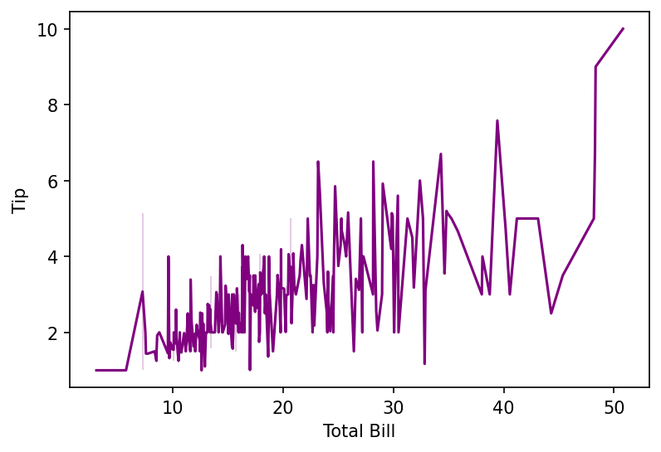
Visualizing Data
Line Plots
For example, in our previous example, it would not make sense to draw a line between the points!
X

Slide 37
Visualizing Data
Line Plots
The line connecting total bills of separate parties doesn’t represent anything.
X

Slide 38
Visualizing Data
Line Plots
Here a line is misleading, indicating some known relationship between each party bill!
X

Slide 39
Visualizing Data
Line Plots
A trend line would have been the correct way to address a need to show linear fit.
X

Slide 40
Visualizing Data
Line Plots
A trend line would have been the correct way to address a need to show linear fit.
X

Slide 41
Visualizing Data
Line Plots
So when is a line plot appropriate?
X

Slide 42
Visualizing Data
Line Plots
So when is a line plot appropriate?
When we already know for certain there is a continuous relationship between data points along a feature. For example, timestamps. We know for certain there are continuous times in between each time stamped point.
X

Slide 43
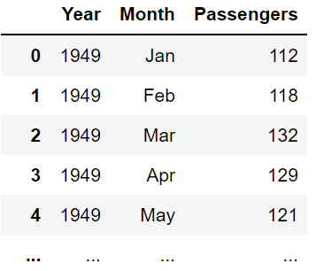
Visualizing Data
Line Plots
Imagine the following data set:
X

Slide 44
Visualizing Data
Line Plots
Imagine the following data set:
X

Slide 45
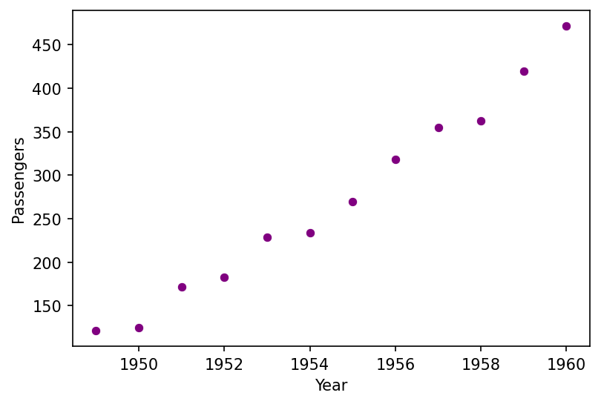
Visualizing Data
Line Plots
We know flights occurred between years!
X

Slide 46
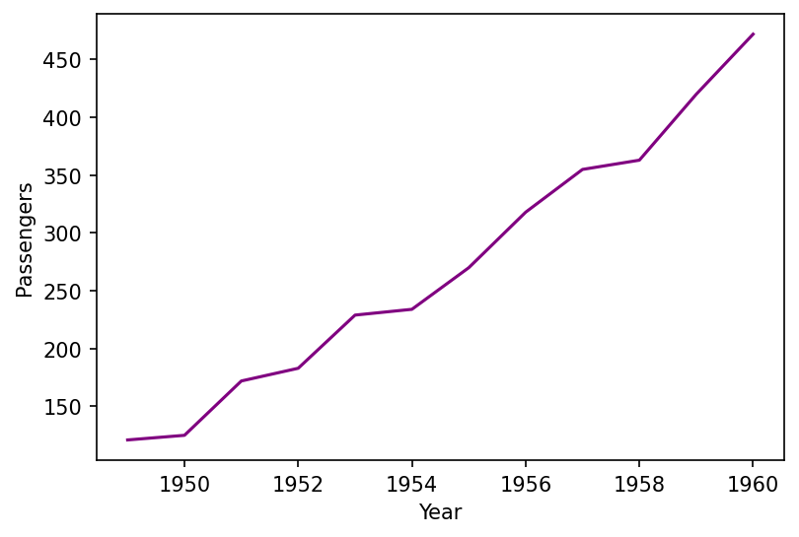
Visualizing Data
Line Plots
A line indicates that continuous knowledge.
X

Slide 47
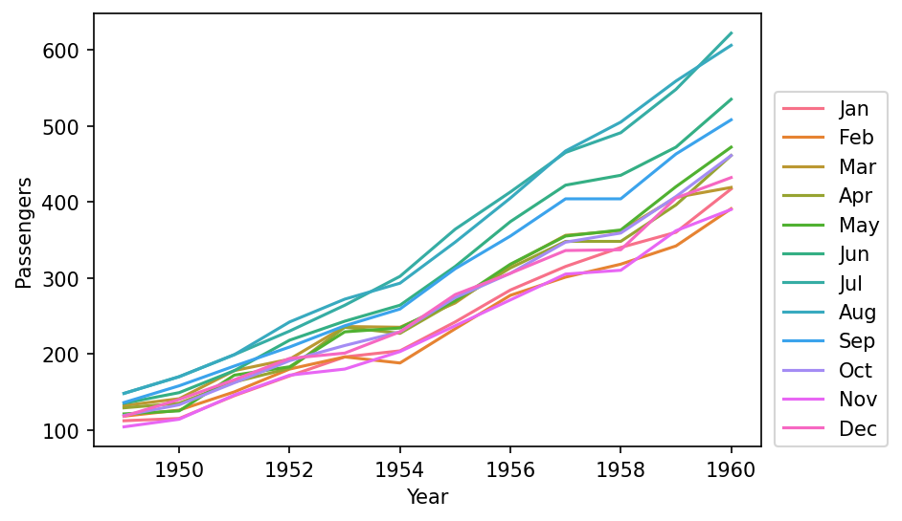
Visualizing Data
Line Plots
Line plots also make it easy to stack features:
X

Slide 48
Visualizing Data
Distribution Plots
X

Slide 49
Visualizing Data
Distribution Plots
Recall our discussions on measurements of dispersion of data. Distribution plots allow us to visualize the dispersion of data across a feature or variable. One of the most common ways to do this is through a histogram.
X

Slide 50
Visualizing Data
Distribution Plots
Let’s revisit our “tips” data set:
X

Slide 51
Visualizing Data
Distribution Plots
What is the distribution of Total Bill amounts?
X

Slide 52
Visualizing Data
Distribution Plots
What is the distribution of Total Bill amounts?
We could answer this through some statistical metrics:
Mean Total Bill is $18.79 with a standard deviation is $8.9 with a min value of $3.07 and max value of $50.81.
X

Slide 53
Visualizing Data
Distribution Plots
What is the distribution of Total Bill amounts?
We could answer this through some statistical metrics:
Mean Total Bill is $18.79 with a standard deviation is $8.9 with a min value of $3.07 and max value of $50.81.
X

Slide 54
Visualizing Data
Distribution Plots
A histogram will count the number of occurrences within a range and then create a bar of the height of the count of the occurrences within the range.
Note how the x-axis feature is continuous, this must be the case for a histogram!
X

Slide 55
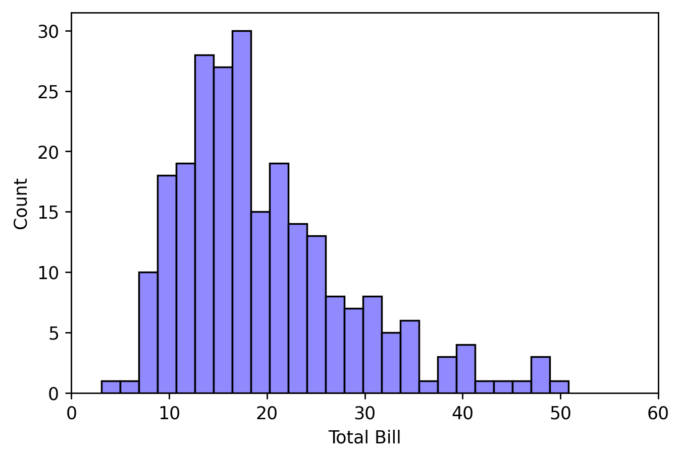
Visualizing Data
Distribution Plots
X

Slide 56
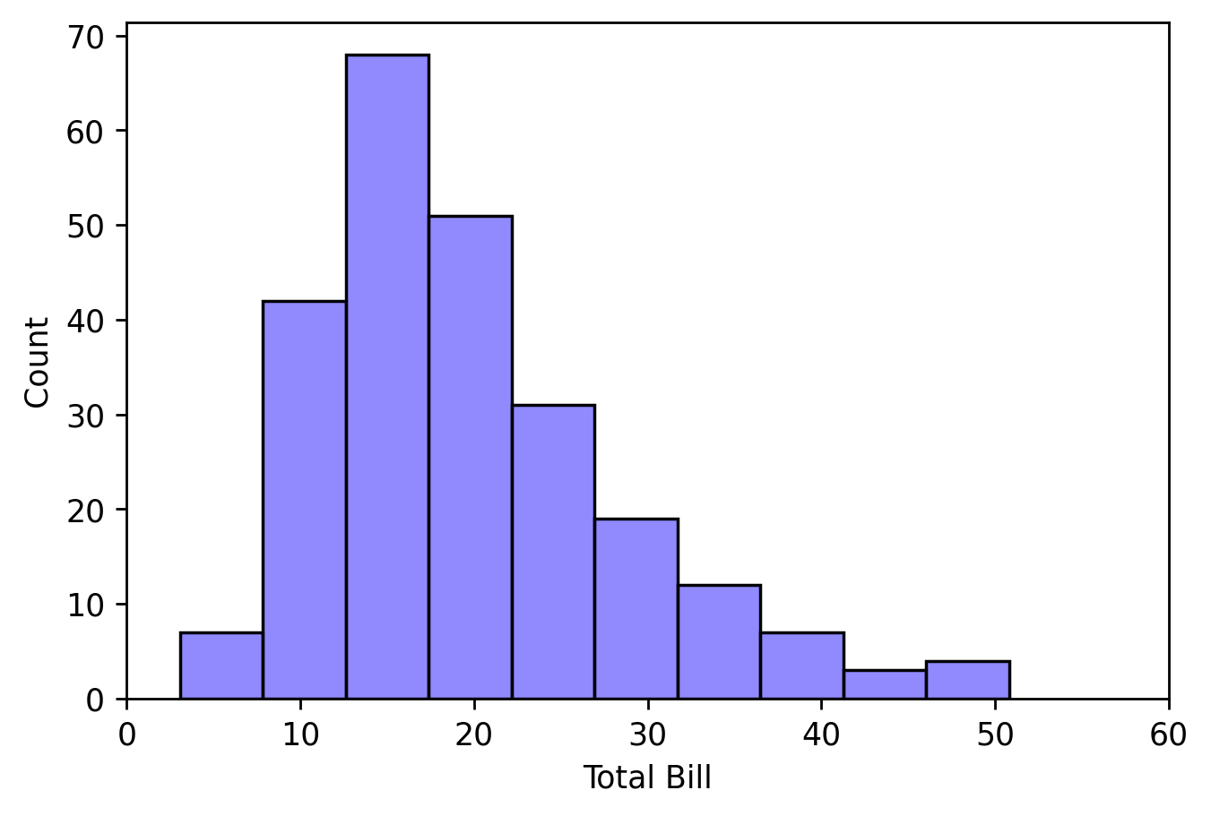
Visualizing Data
Distribution Plots
X

Slide 57
Visualizing Data
Distribution Plots
X

Slide 58
Visualizing Data
Distribution Plots
There are many more types of plots to display distribution, such as box-and-whisker plots and KDE (Kernel Density Estimation) plots, but by far the most common you will encounter is the histogram.
X

Slide 59
Visualizing Data
Categorical Plots
X

Slide 60
Visualizing Data
Categorical Plots
Categorical plots simply display some metric per category. For example, a mean value per category or a count per category. There are many variations of these types of plots, but one of the most common is the simple bar plot.
X

Slide 61
Visualizing Data
Categorical Plots
Be careful not to confuse the bar plot for a histogram! While they may appear similar, carefully look at the x-axis feature. For a bar chart, the feature is categorical while for a histogram it is continuous!
X

Slide 62
Visualizing Data
Categorical Plots
X

Slide 63
Visualizing Data
Categorical Plots
X

Slide 64
Visualizing Data
Categorical Plots
Total expenditure per day?
X

Slide 65
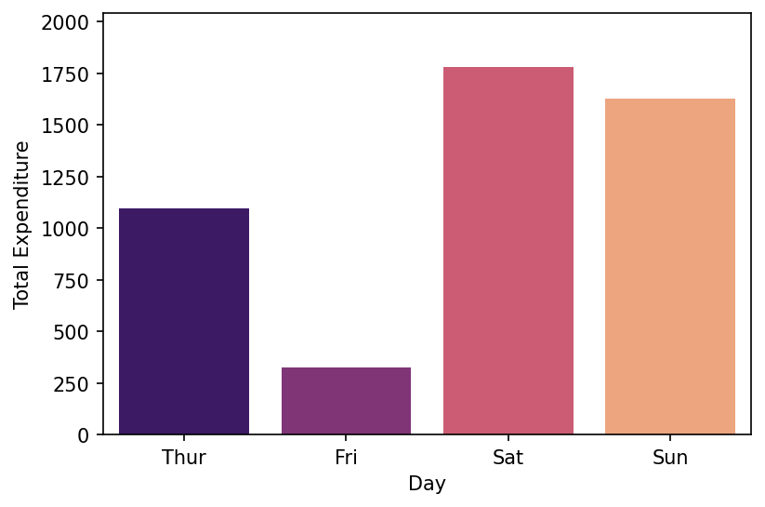
Visualizing Data
Categorical Plots
Total expenditure per day?
X

Slide 66
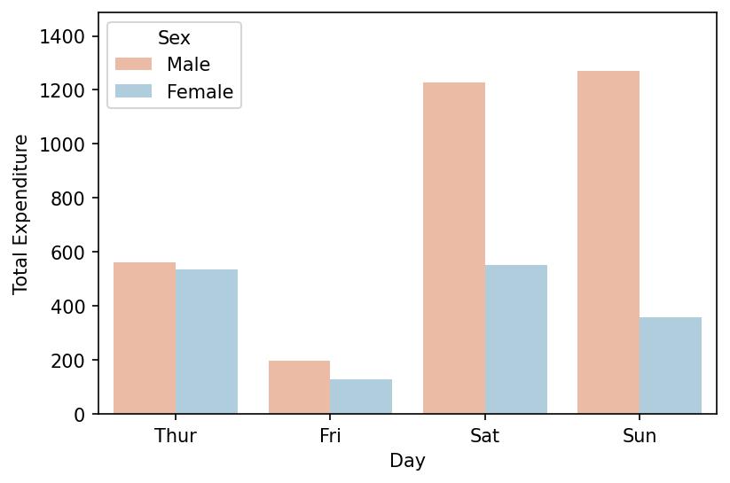
Visualizing Data
Categorical Plots
Total expenditure per day?
X

Slide 67
Visualizing Data
Remember that there are a lot more types of visualizations than the ones shown here on our quick “tour”, but you should always keep in mind first:
“What is the information I want to share or story I am trying to tell? How does this visualization help in conveying that information to others?”
X

